Slide 1
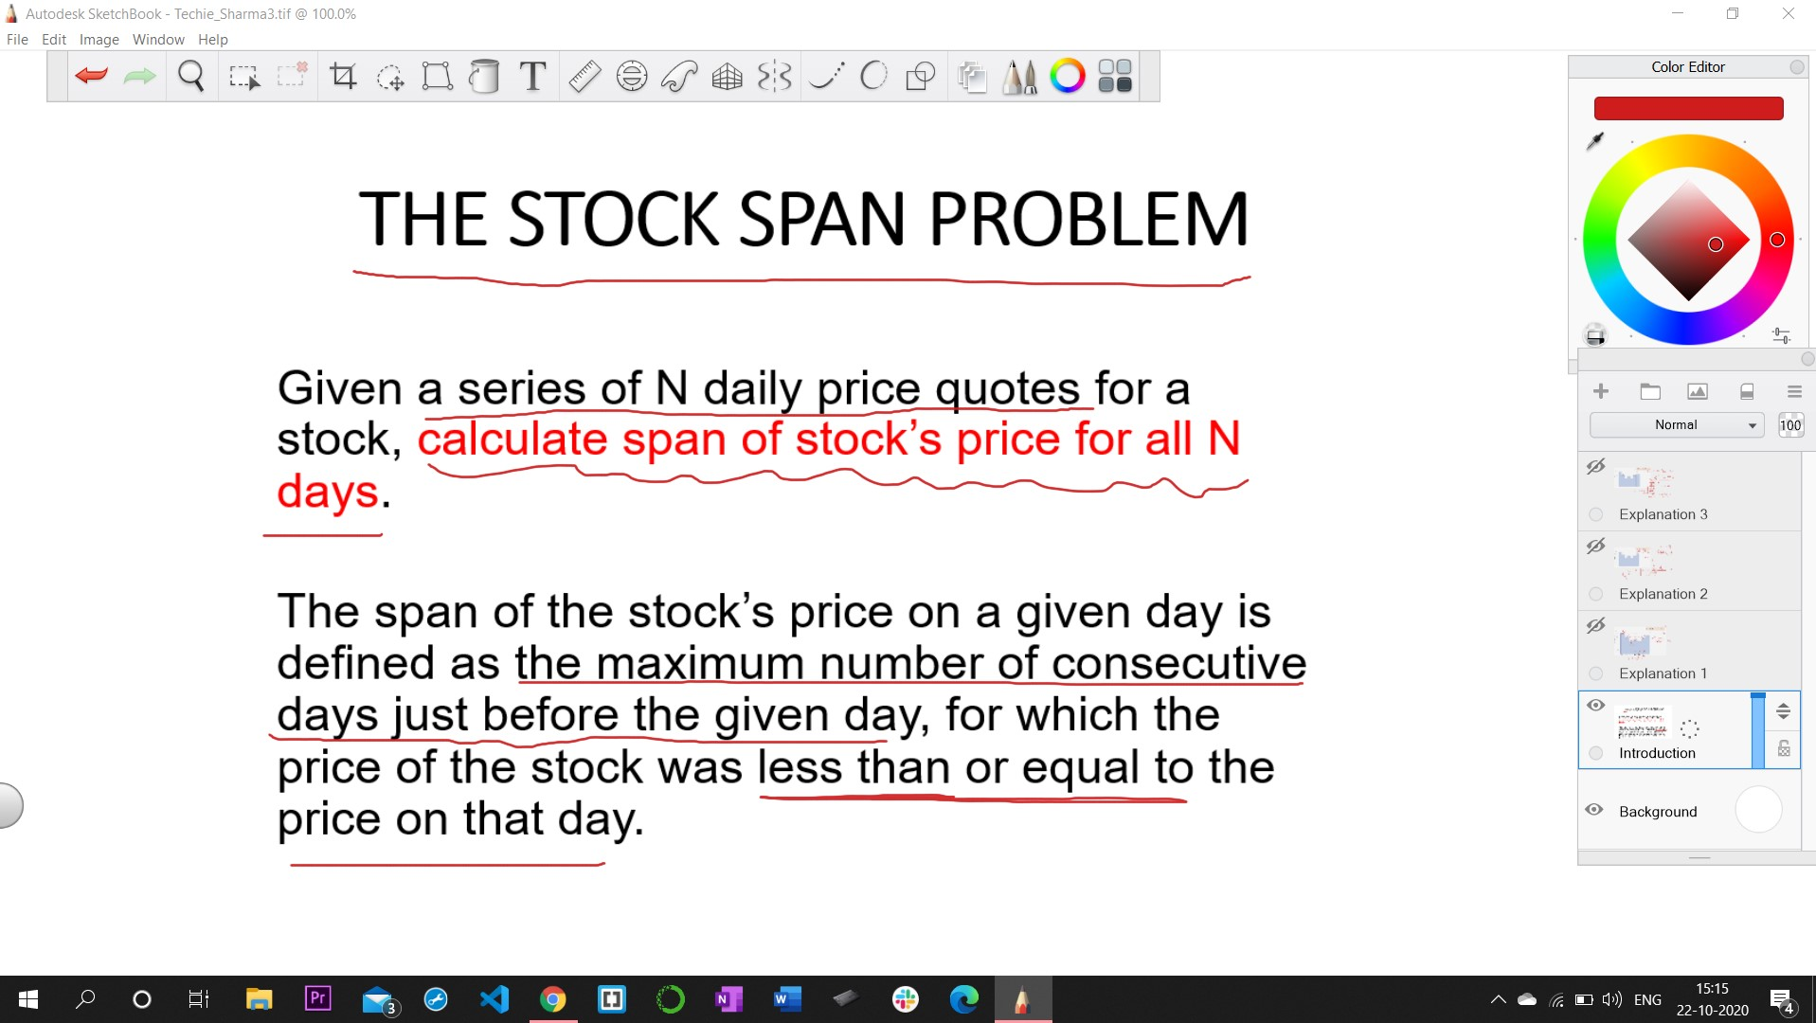

Slide 2
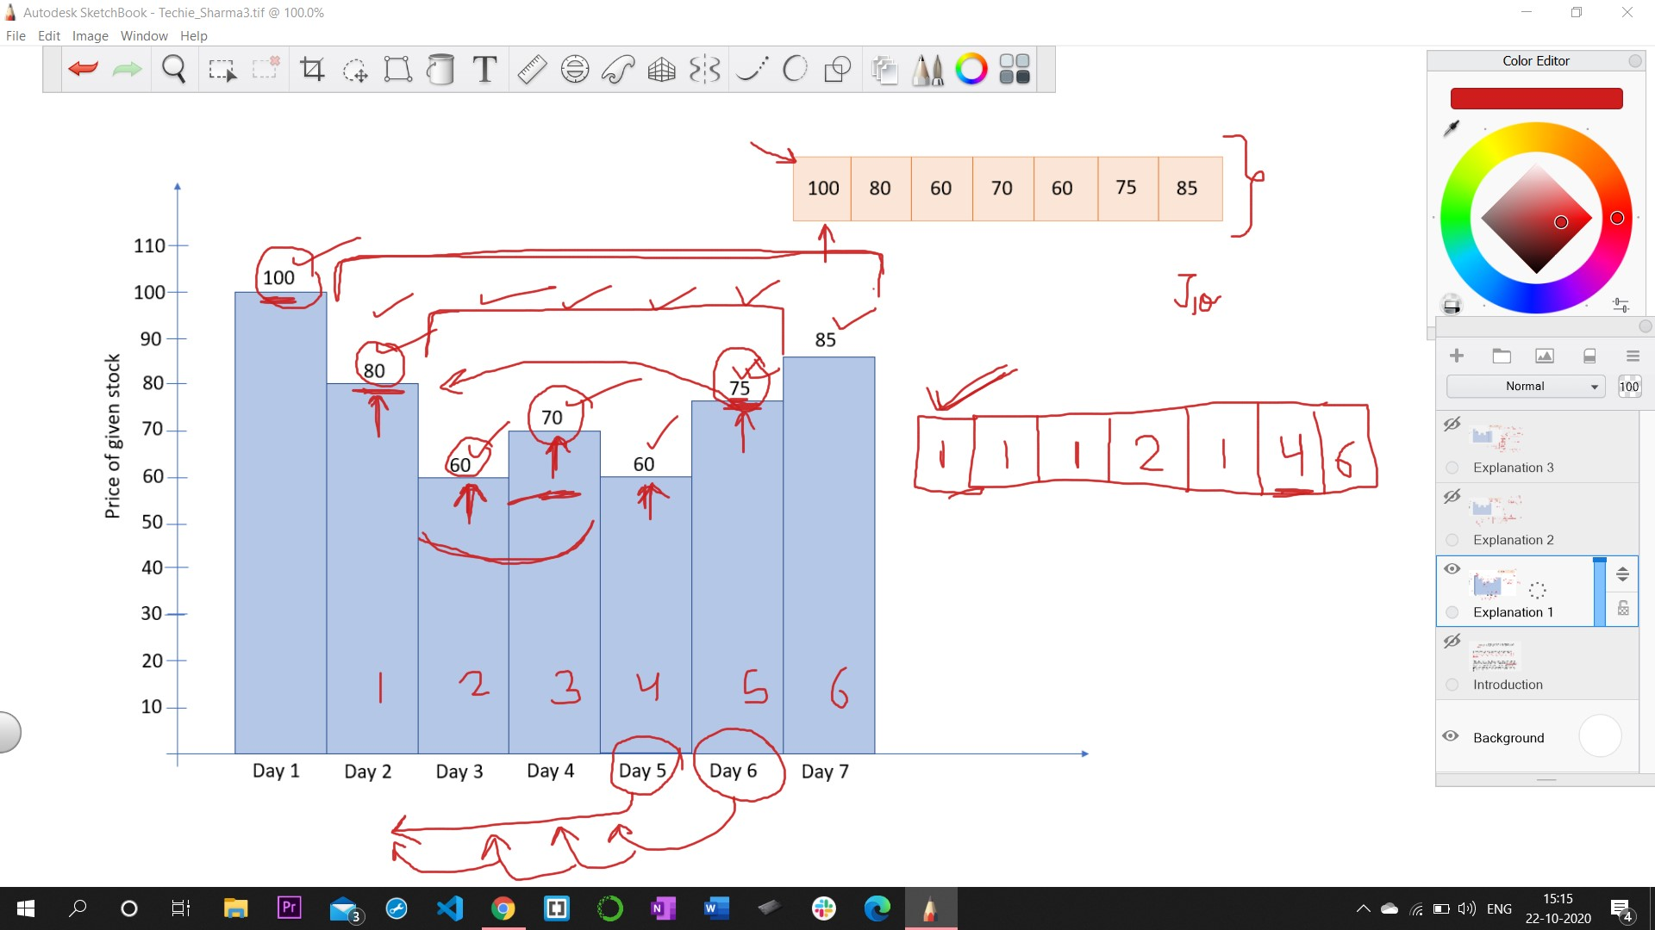

Slide 3
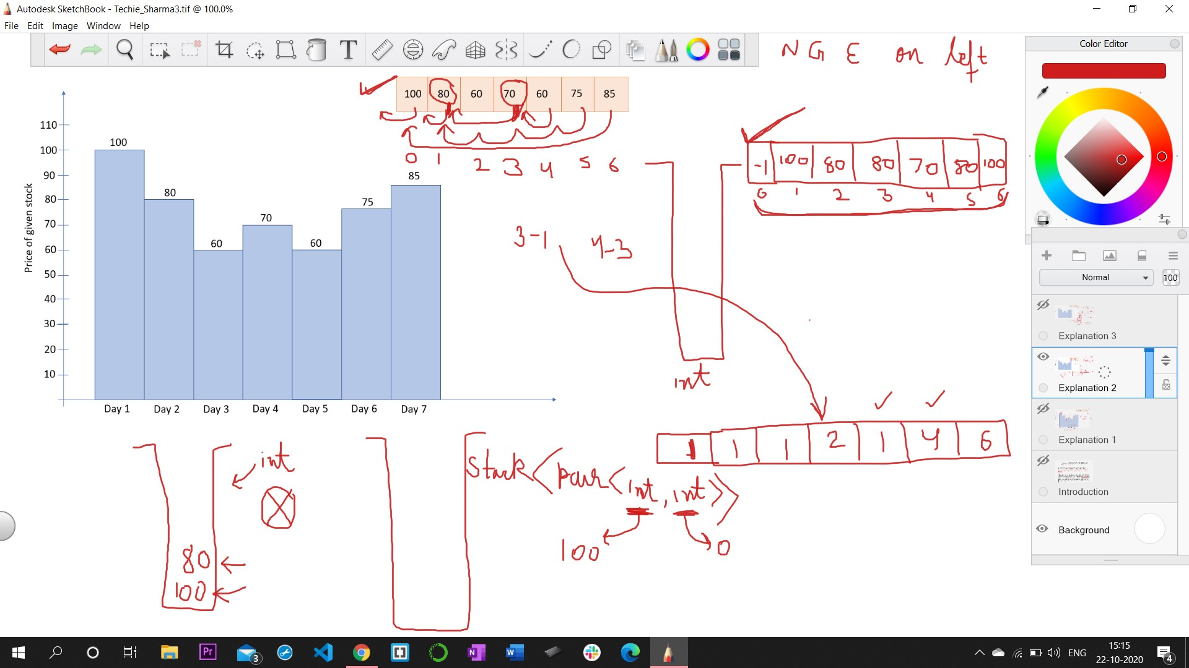

Slide 4
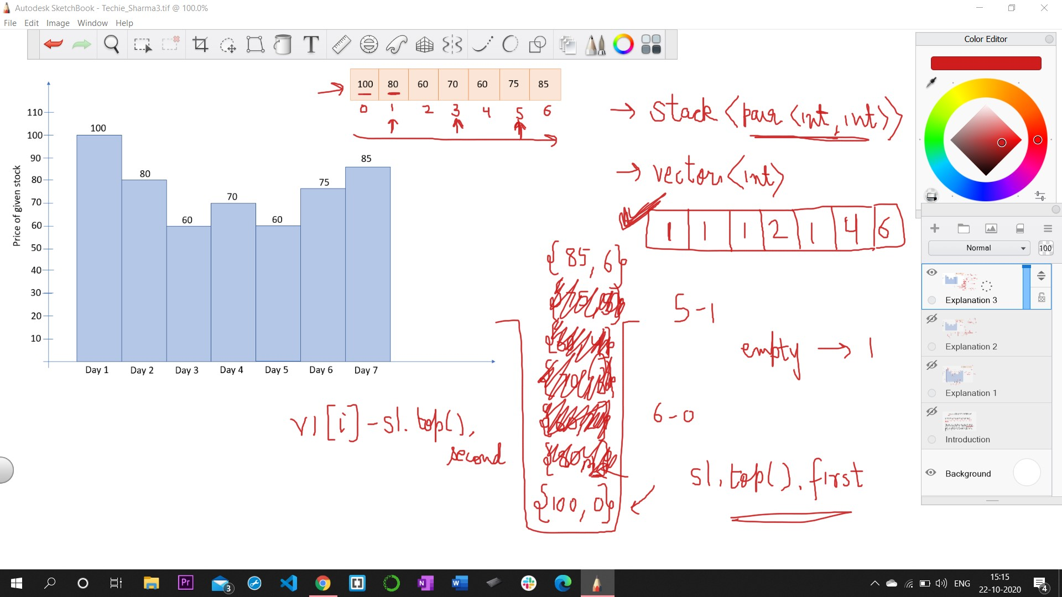

Slide 5





THANKS FOR WATCHING!
CONNECT WITH ME:
https://www.linkedin.com/in/piyushsharma220699/
@piyush_sharma226

